Slide 1
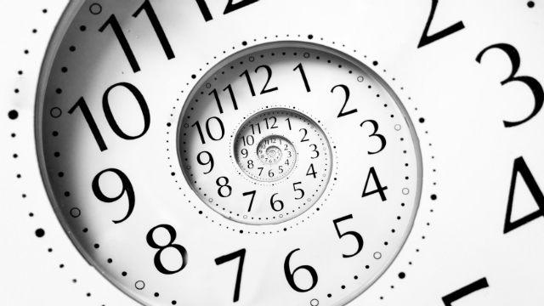
في وقته
الجامعة 3: 1-15
د. ريك جريفيث • كنيسة الطرق المتقاطعة الدولية سنغافورة
CICFamily.com • BibleStudyDownloads.org

Slide 2
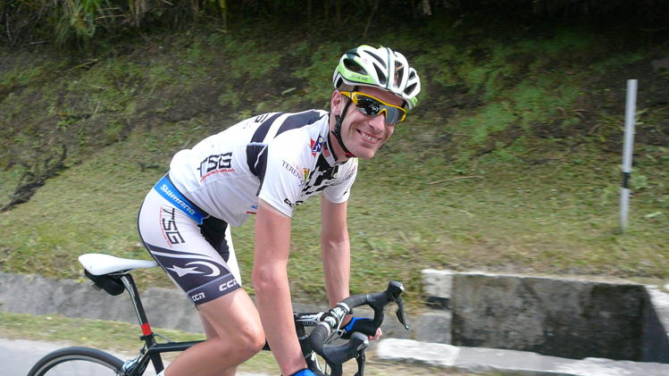
مارتن دي جونغ
Notes:
Newser reports that 29-year-old “Maarten de Jonge is a lucky man—two times over. The Dutch cyclist had a ticket for not only [the 17 July 2014] doomed Malaysia Airlines Flight 17, but also the still-missing Malaysia Airlines Flight 370. Both times, ABC News reports, de Jonge changed his flight at the last minute… Like the rest of us, he lives ignorant of his time to die. I wonder if he’s thinking about this now!

Slide 3
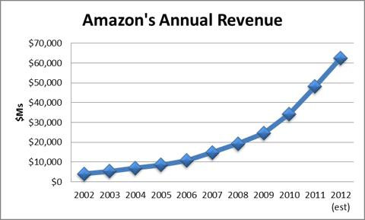
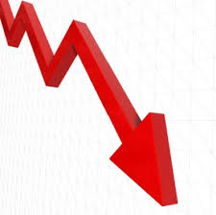
إيرادات أمازون السنوية
Notes:
Amazon lost 10% of its share price on Friday. If you knew this was going to happen on Thursday and you had $100,000 in Amazon shares, what would you have done? We all make investment decisions based on incomplete knowledge of God’s timing.
Of course, none of us know the right time for anything—when to change a flight, buy or sell, how long to wait. We all make decisions based on incomplete information.

Slide 4
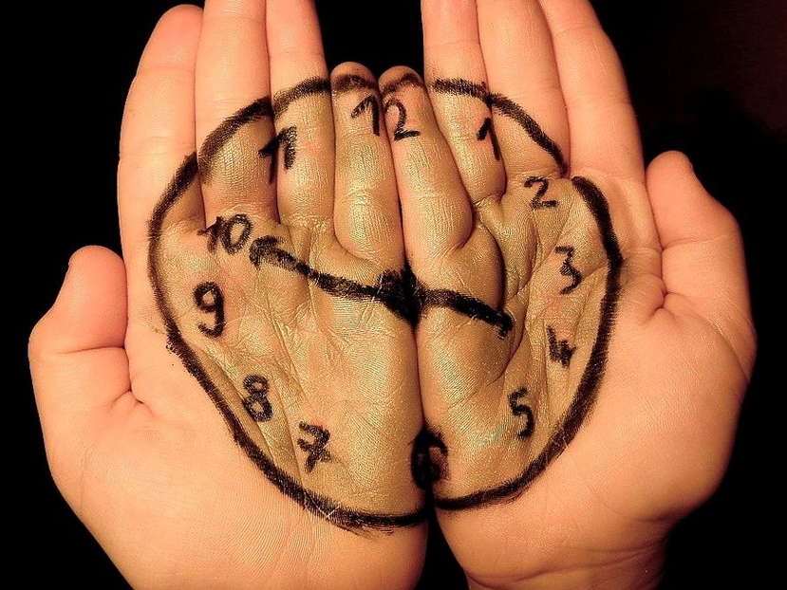
ماذا تنتظر؟

Slide 5
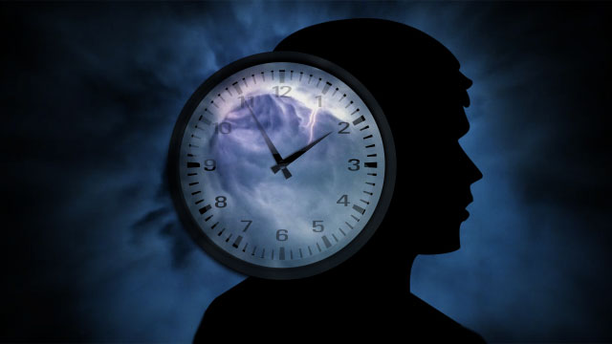
هل تنتظر شخصاً تهتم به حتى يثق بالمسيح؟

Slide 6
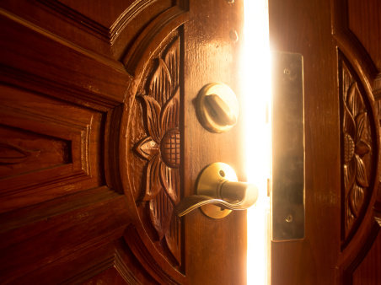
هل تنتظر الله حتى يفتح لك باباً – وظيفة، بيت، أو فرصة أخرى؟

Slide 7
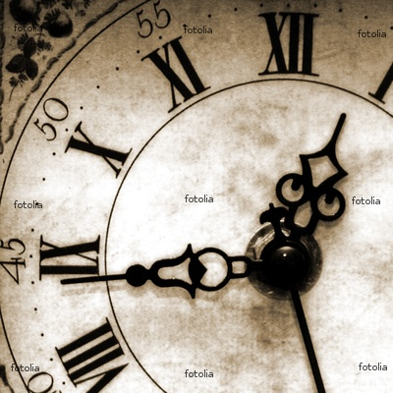
كم شخصاً منا ينتظر شيئاً ما؟

Slide 8
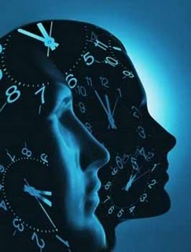
كيف تعيش عندما لا تعرف توقيت الله؟

Slide 9
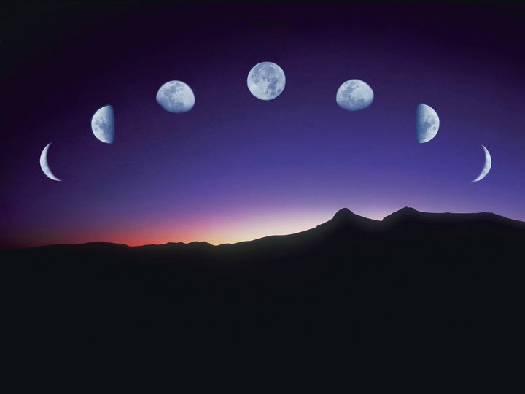
الجامعة
العمل والحكمة لا يدومان

Slide 10
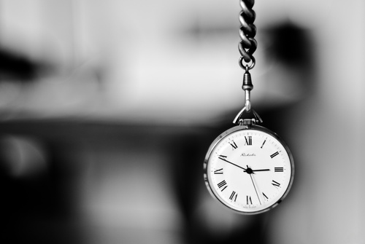
إلى أين نحن ذاهبون اليوم ...
طريقتان
الله كامل
كيف نتجاوب

Slide 11
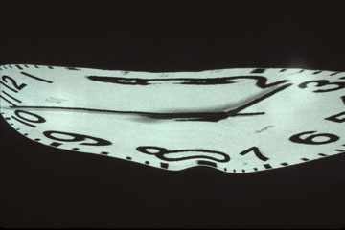
الله كامل في ذلك ....
جامعة 3: 1-15

Slide 12
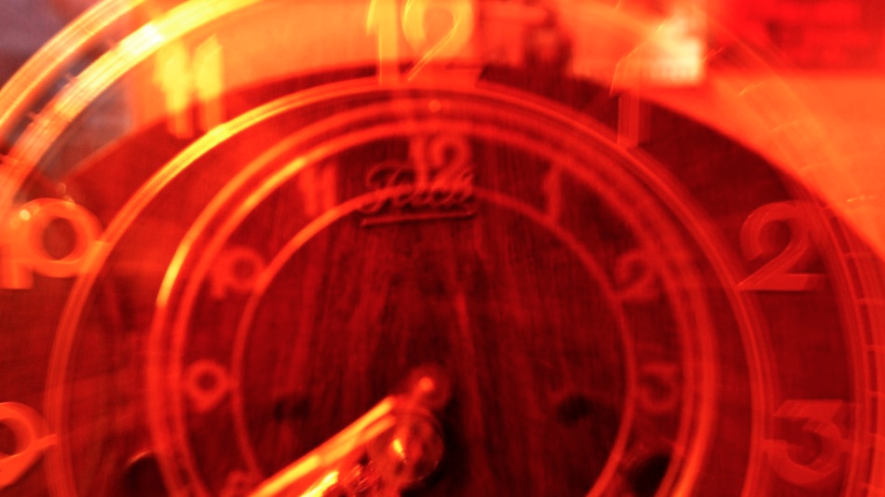
توقيت الله دقيق (3: 1-8)
Notes:
He causes events at the flawless moment!

Slide 13
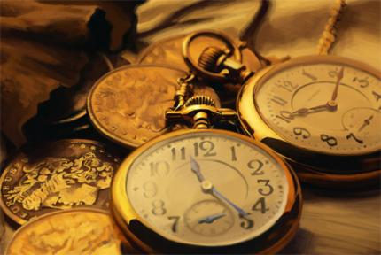
الرسالة : لكل نشاط وقته المحدد (3: 1)

Slide 14
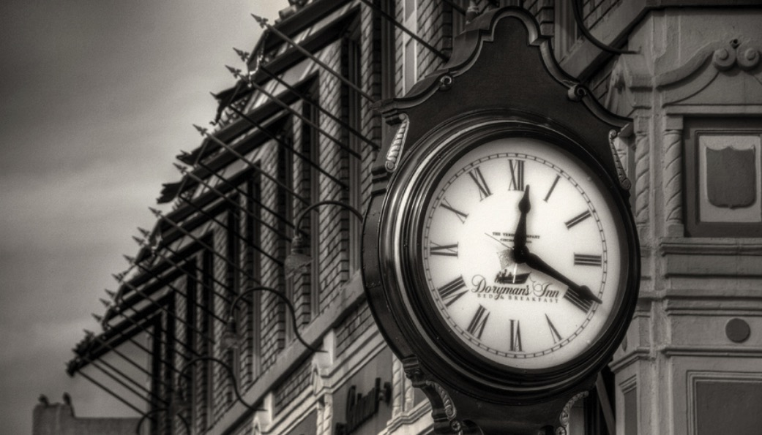
الجامعة 3: 1أ
لكل شيء
زمان

Slide 15
ولكل أمر تحت السماوات وقت (3: 1ب)
409

Slide 16
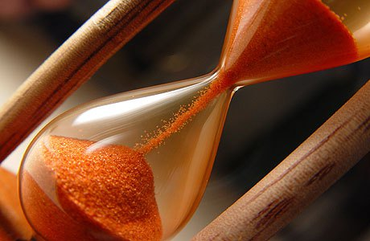
(NET ملاحظات الكتاب المقدس) موسم
الوقت المعين أو المحدد للأعياد اليهودية (أستير 9: 27، 31) وطول الوقت الذي حدده نحميا لغيابه عن شوشن (نح 2: 6).

Slide 17
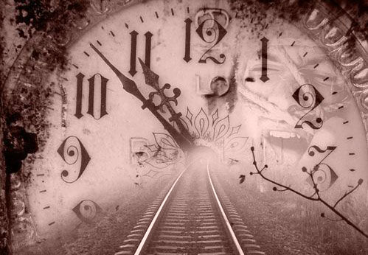
الدليل: لدى الله توقيت كامل لكل نشاط (3: 2-8)

Slide 18
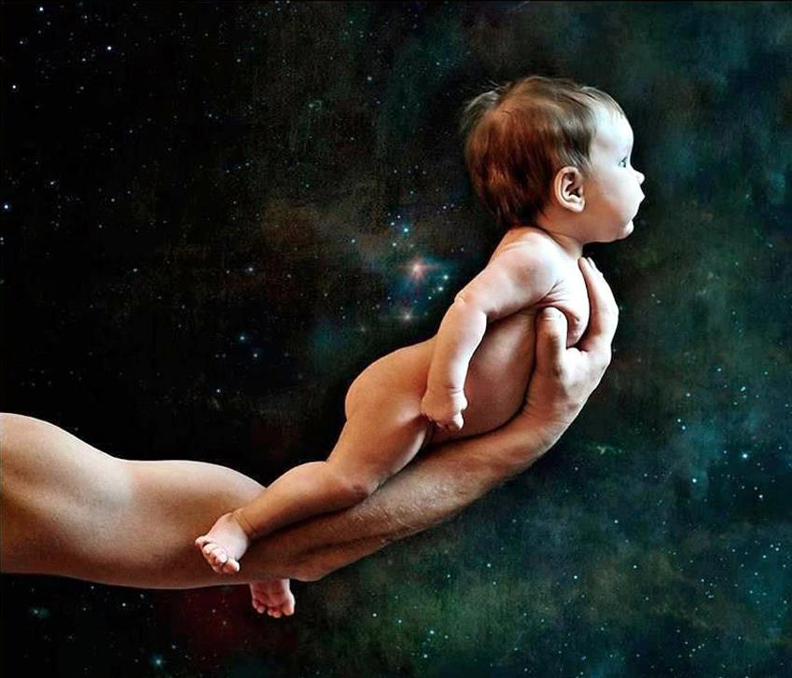
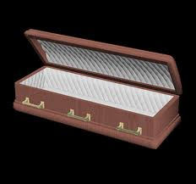
للولادة وقت ...
وللموت وقت (3: 2أ)

Slide 19
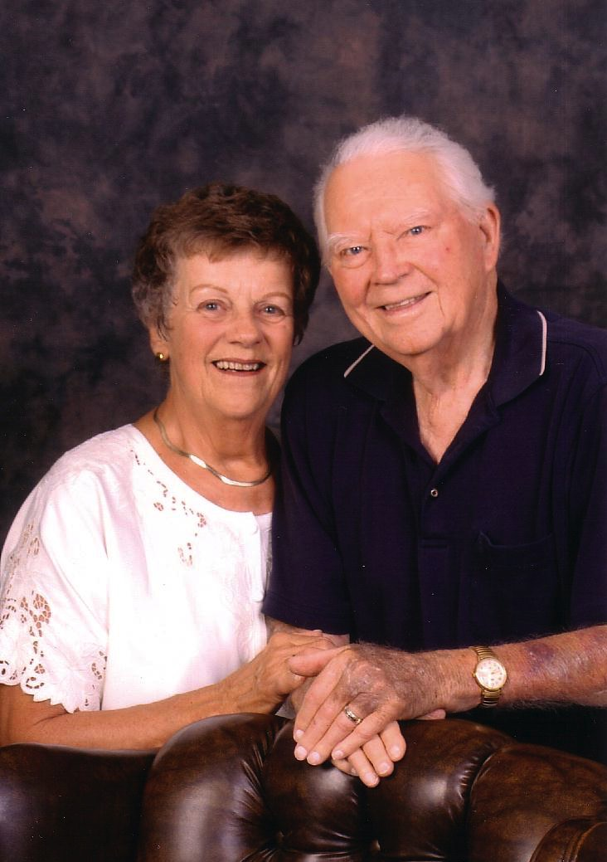
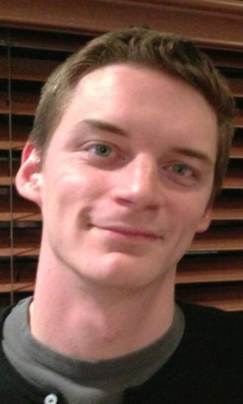
والدا سوزان
كيرت ودوريس

Slide 20
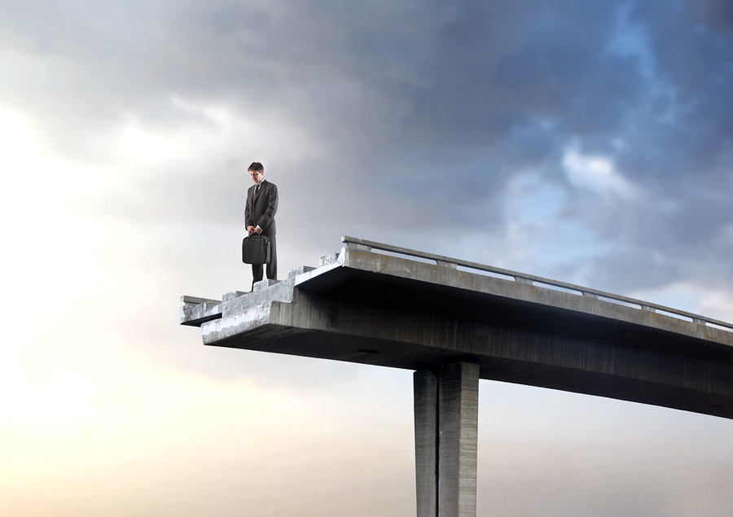
... وفي سفرك كلها كتبت يوم تصورت، إذ لم يكن واحد منها (مز 139: 16ب)

Slide 21
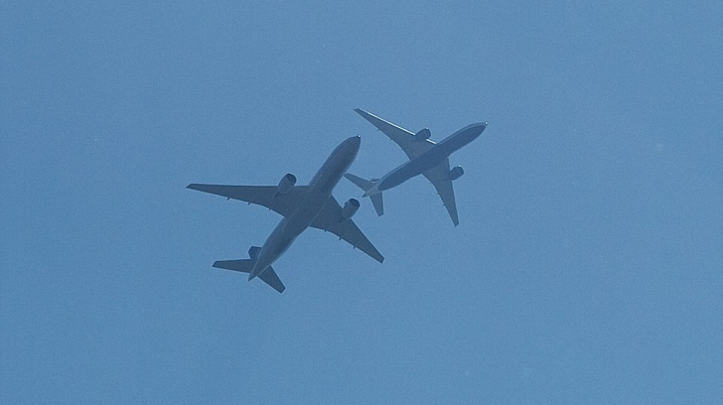
رحلتان، نفس الوجهة
Notes:
When will you die? None of us knows! My wife and I had friends with four teenagers who fear an airplane accident that could kill them both. So Danny and Becky never fly together. They go to the airport together, take separate flights to their destination (they live in Hungary), and meet up at the airport on the other end. Makes sense, right? They see this as being responsible before God as parents.
The rest of us don’t know any more than Danny and Becky. I can’t predict which plane will crash or which car will spin out of control on the way to the airport—which, I hear, is more dangerous than taking a flight, by the way!

Slide 22
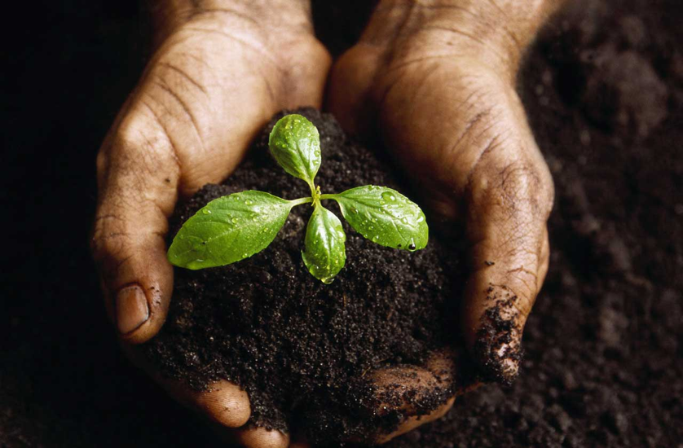
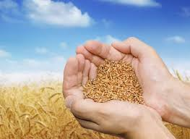
للغرس وقت
ولقلع المغروس وقت (3: 2ب)

Slide 23
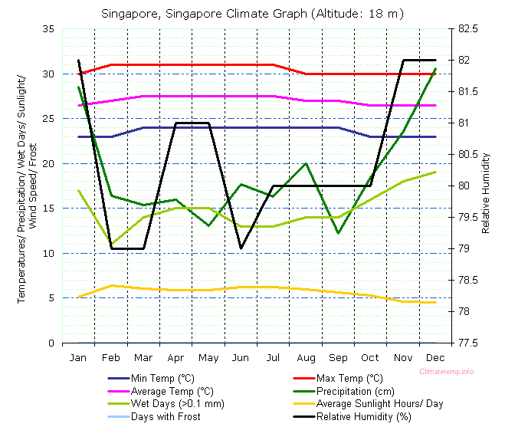
مواسم سنغافورة
http://misfitsarchitecture.com/2013/03/08/its-not-rocket-science-7-evapo-transpiration/
Notes:
http://misfitsarchitecture.com/2013/03/08/its-not-rocket-science-7-evapo-transpiration/

Slide 24
للغرس وقت
ولقلع المغروس وقت (3: 2ب)

Slide 25
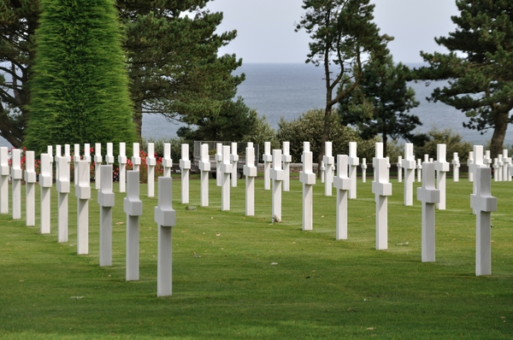
للقتل وقت
وللشفاء وقت (3: 3أ)

Slide 26
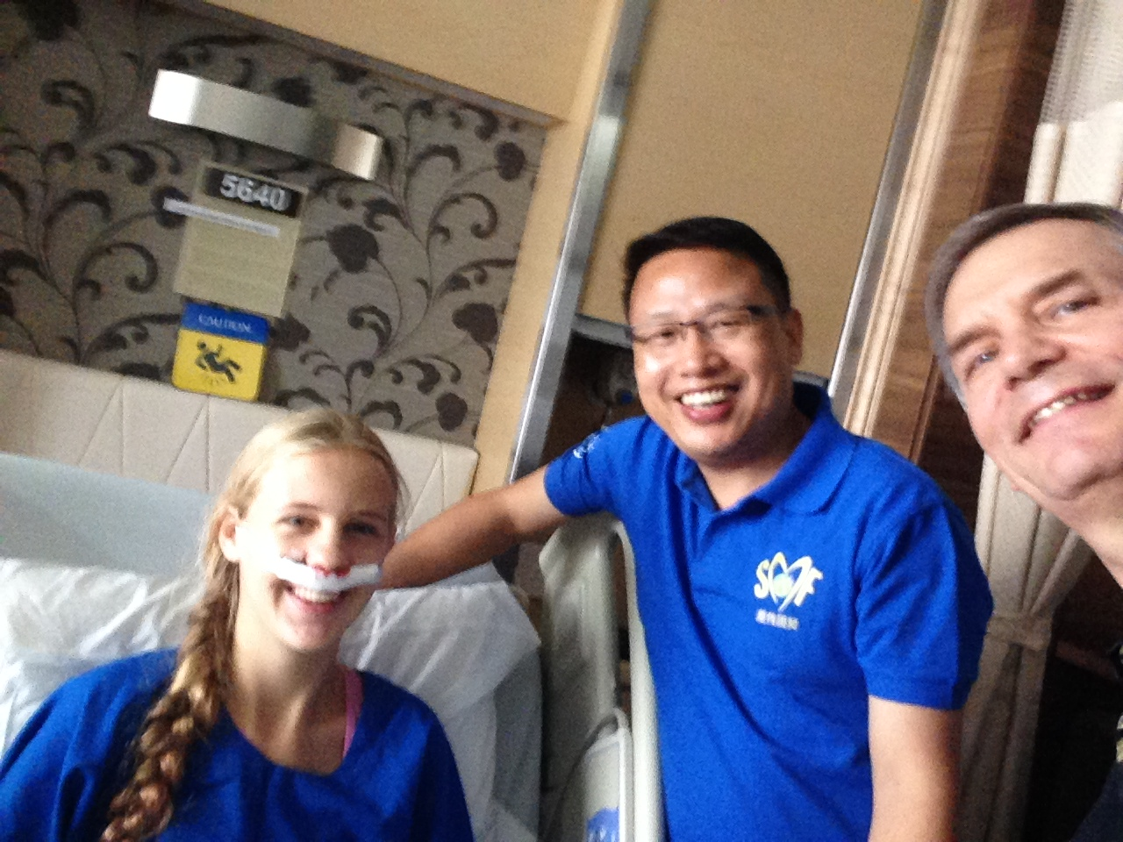
للشفاء وقت

Slide 27
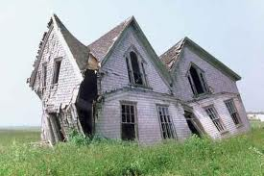
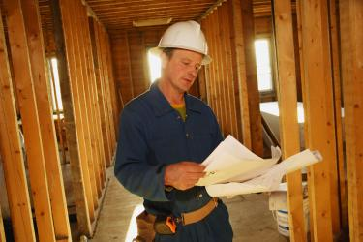
للهدم وقت
وللبناء وقت
(3: 3ب)

Slide 28
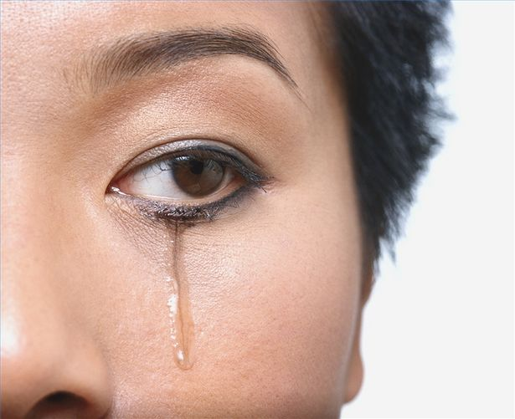
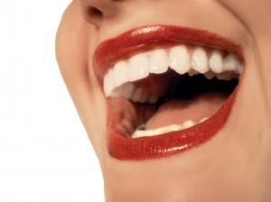
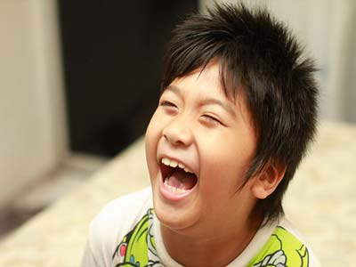
للبكاء وقت
وللضحك وقت (3: 4أ)

Slide 29
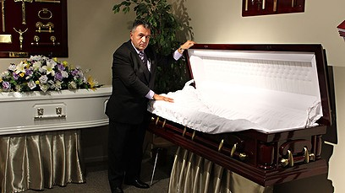
مدير الجنازة
Notes:
I love laughter! Swindoll writes, “I heard about a pastor who left the pastorate after 20 years. He decided to become a funeral director. Somebody asked, ‘Why did you do that?’ He answered: ‘Well, I spent about 12 years trying to straighten out John. He never did get straightened out. I spent 14 months trying to straighten out the marriage of the Smith’s, and it never did get straightened out. I spent three years trying to straighten out Susan, and she never did get straightened out. Now when I straighten them out, they stay straight” (Living on the Ragged Edge, 72)

Slide 30
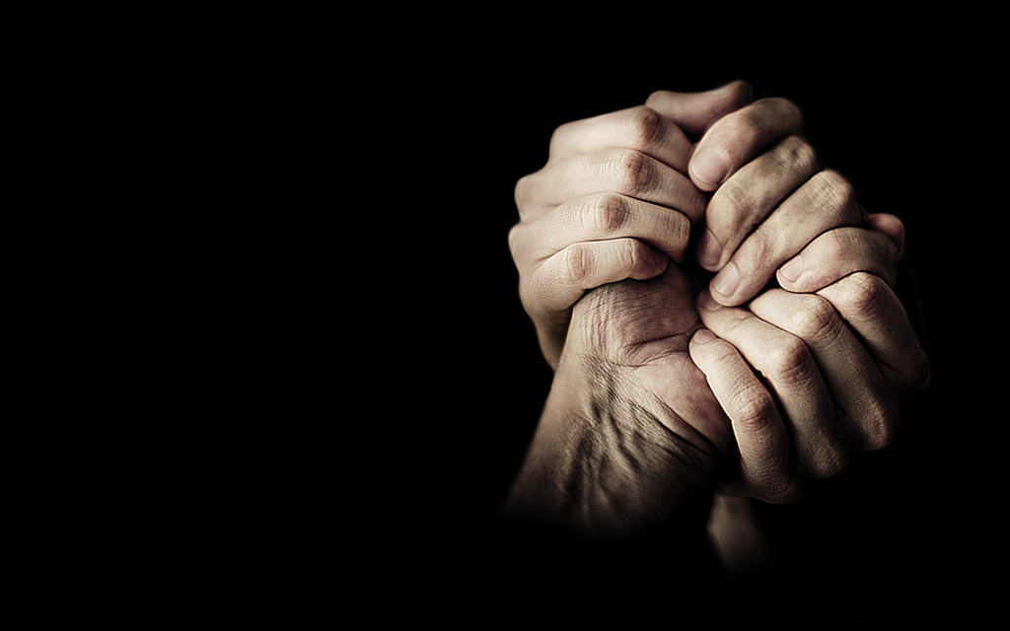
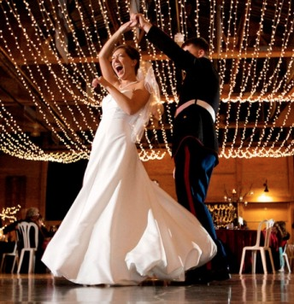
للنوح وقت
وللرقص وقت (3: 4ب)

Slide 31
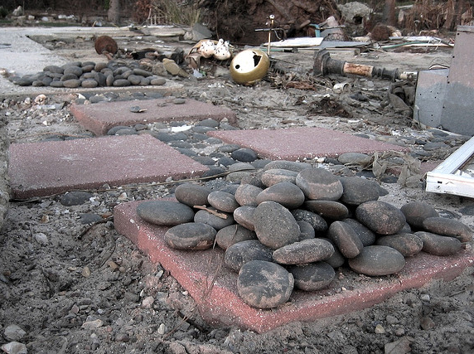
لتفريق الحجارة وقت ...
ولجمع الحجارة وقت
(3: 5أ)

Slide 32
حجارة التذكار
نتذكر اليوم ست سنوات من أمانة الله لكنيسة الطرق المتقاطعة

Slide 33
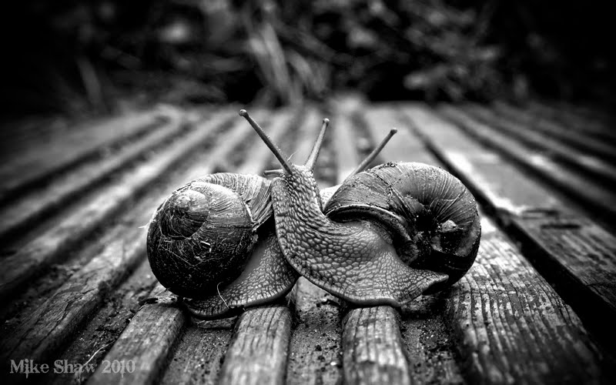
للمعانقة وقت ...
وللإنفصال عن المعانقة وقت (3: 5ب)

Slide 34
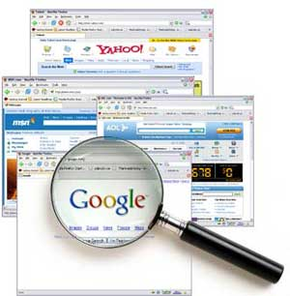
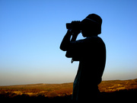
للكسب وقت ...
وللخسارة وقت
(3: 6أ)

Slide 35
النملة والعدسة اللاصقة
Notes:
“Brenda was a young woman who was invited to go rock climbing. Although she was very scared, she went with her group to a tremendous granite cliff. In spite of her fear, she put on the gear, took hold of the rope, and started up the face of the rock.
Well, she got to a ledge where she could take a breather. As she was resting there, the safety rope snapped against Brenda’s eye and knocked out her contact lens.
There she was, on a rock ledge, with hundreds of feet below her and hundreds of feet above her. Of course, she looked and looked and looked, hoping her contact lens had landed on the ledge, but it was just not there.
• Here she was, far from home, her sight was now blurry. Brenda was desperate and began to get upset. She prayed to the Lord to help her to find it. When she got to the top, a friend examined her eye and her clothing for the lens, but there was no contact lens to be found.

Slide 36
لأن عيني الرب تجولان في كل الأرض ليتشدد مع الذين قلوبهم كاملة نحوه (2 أخ 16: 9).
Notes:
Despondent, she sat down with some of the party waiting for them to make it up the face of the cliff. She looked out across the range of mountains and thought of the Bible verse that said: “For the eyes of the Lord run to and fro throughout the whole earth …” (2 Chronicles 16:9).
She thought “Lord, you can see these mountains. You know every stone and leaf and you know exactly where my contact lens is. Please help me. Finally, she walked down the trail to the bottom. A new party of climbers was just starting up the face of the cliff. One of them shouted out: “Hey guys! Anybody lose a contact lens?”

Slide 37
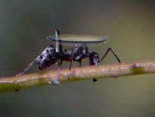
النملة والعدسة اللاصقة
Notes:
Well, that would be startling enough, but do you know where the climber saw it? An ant was moving slowly across the face of the rock, carrying it on his back. The story gets better. Brenda’s father is a cartoonist.

Slide 38
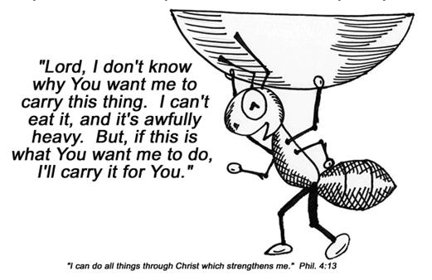
يا رب، لا أعرف لماذا تريد مني أن أحمل هذا الشيء، لا أستطيع أكله وهو ثقيل جداً، ولكن إذا كان هذا هو ما تريد مني أن أفعله، فسوف أحمله نيابةً عنك.
أستطيع كل شيء في المسيح الذي يقويني (في 4: 13)
Notes:
When she told him the incredible story of the ant, her prayer and the contact lens, he drew a picture of an ant lugging that contact lens with the words: “Lord, I don’t know why you want me to carry this thing. I can’t eat it, and it’s awfully heavy. But if that’s what you want me to do, I’ll carry it for you.”

Slide 39
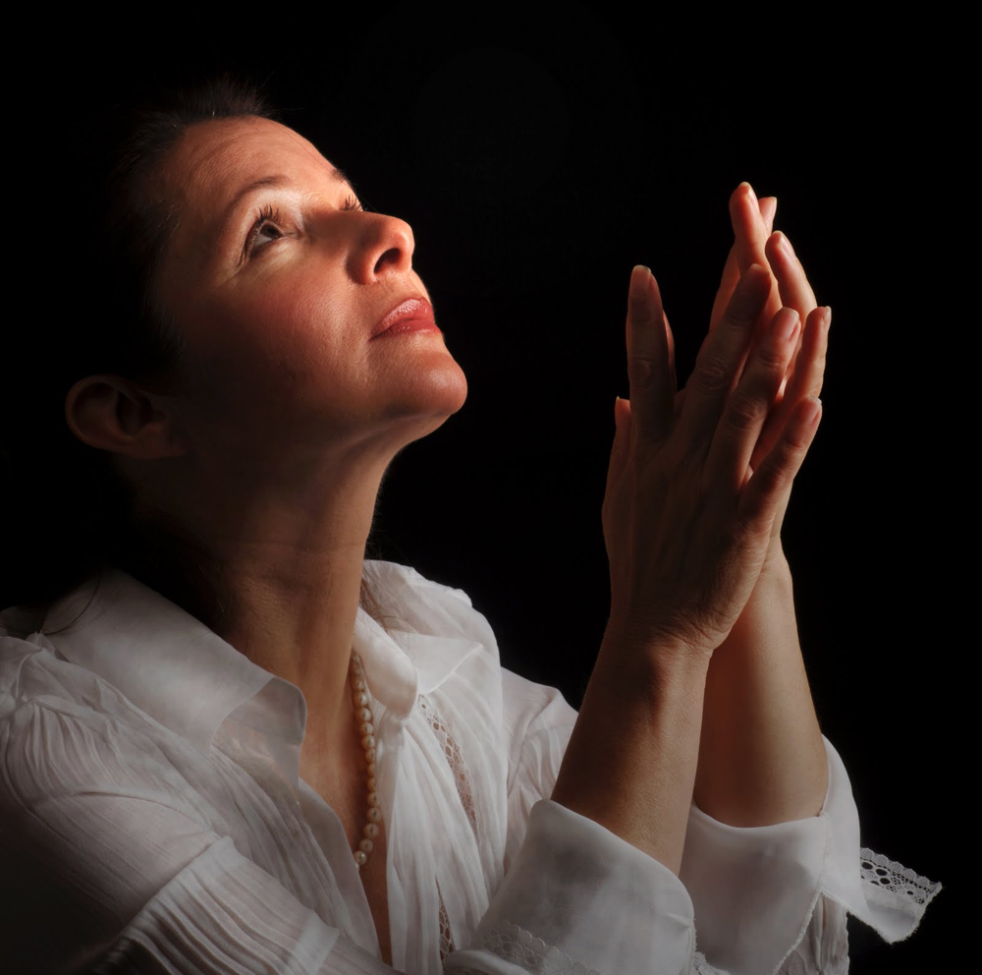
النملة والعدسة اللاصقة
Notes:
I think it would do some of us good to occasionally say, "God, I don't know why you want me to carry this load. I can't see any good in it and it's awfully heavy. But if you want me to carry it, I will."
You see, we all have a burden to carry and sometimes we don't know why. It could be just because we are to be an example to someone else or by answered prayer by being humble before God."
"For everything there is a season, a time for every activity under heaven… a time to search and a time to give up as lost" (3:1, 6a NAU).
Are you still searching? Is it time just to give it over the to Lord and even let an ant bring it to you in his good time if God wills it?

Slide 40
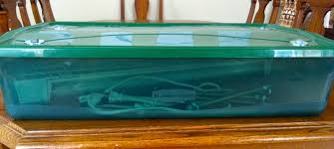
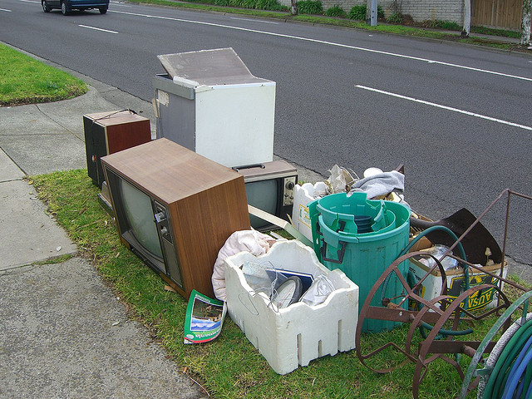
للصيانة وقت ...
وللطرح وقت
(3: 6ب)

Slide 41
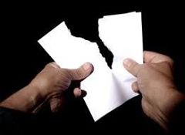
للتمزيق وقت
وللتخييط وقت (3: 7أ)

Slide 42
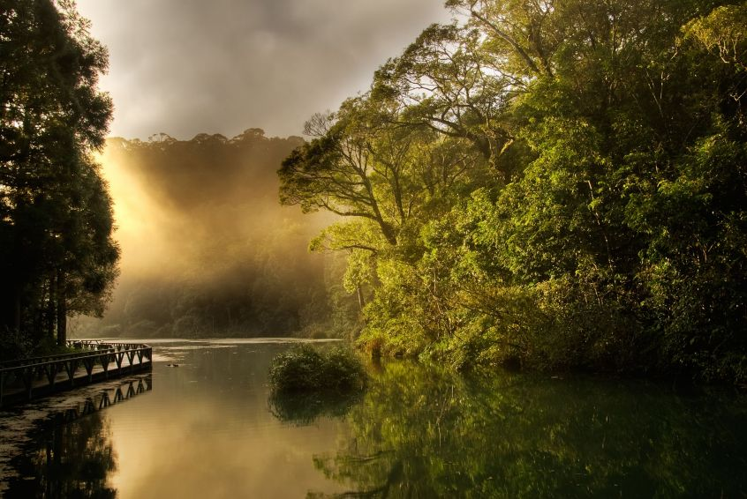
للسكوت وقت ...
وللتكلم وقت
(3: 7ب)

Slide 43
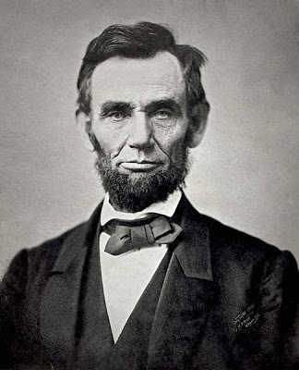
أبراهام لينكولن (1809-1865)
عندما لم يكن لديه ما يقوله، لم يقل شيئاً.

Slide 44
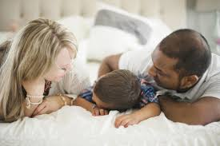
للحب وقت ...
وللبغضة وقت (3: 8أ)

Slide 45
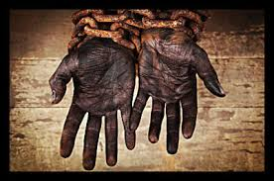
أبراهام لينكولن (1809-1865)
كانت هناك كراهية متزايدة بداخلي ضد العبودية، وأقسمت أنه إذا تمكنت يوماً ما من فعل شيء حيال ذلك، فسوف أفعل شيئاً حيالها.
Notes:
The first time young Abraham Lincoln saw a slave for sale on the block, he recoiled within. He said, “There was a rising hatred inside of me against slavery, and I swore if someday I could do something about it, I would do something about it.” He hated slavery with a passion! There’s a time to hate, there’s a time to love (Swindoll, 76).

Slide 46
للحرب وقت ...
وللصلح وقت
(3: 8ب)

Slide 47
توقيت الله دقيق (3: 1-8)
Notes:
He causes events at the flawless moment!

Slide 48
طرق الله دقيقة (3: 9-11)
Notes:
Our best has limited success, but God does everything right.

Slide 49
فأي منفعة لمن يتعب مما يتعب به (3: 9)

Slide 50
قد رأيت الشغل الذي أعطاه الله بني البشر ليشتغلوا به (3: 10) فاندايك
رأيت كل العمل الشاق
الذي أعطانا إياه الله لنعمله
(3: 10) المبسطة

Slide 51
صنع الكل حسناً في وقته (3: 11أ)
* مناسباً، لائقاً، 5: 18
Notes:
The Hebrew reads literally "beautiful" but the idea is more properly "appropriate" or "fitting"

Slide 52
في وقته ديان بول (بالإعتماد على جامعة 3: 11) CCLI Song # 25981 © 1978 CCCM Music (Admin. by Maranatha! Music (Capitol CMG)) CCLI Licence # 277507

Slide 53
في وقتك، في وقتك تصنع كل الأشياء جميلة في وقتك

Slide 54
يا رب، أظهر لي في كل يوم بينما تعلمني طريقك أنك تفعل تماماً كما تقول في وقتك

Slide 55
في وقتك، في وقتك تصنع كل الأشياء جميلة في وقتك

Slide 56
يا رب، أحضر حياتي لك لتكن كل ترنيمة لديَّ أغنيها محبوبة لديك في وقتك

Slide 57
وأيضا جعل الأبدية في قلبهم (3: 11ب)
Notes:
God has placed a longing in man to know how he and his activities relate to eternity (3:11b).

Slide 58
إدوارد ب. تايلور (أبو علم الإنسان)
Notes:
Don Richardson records in his book Eternity in Their Hearts, that Lenin and Marx thought the work of Edward B. Tylor (“the father of anthropology”) would finally destroy religion. Tylor wanted to show that belief in God was not innate but foisted upon us by the religionists. Richardson writes…
“The theory, according to scientific procedure, needed to be tested and confirmed by anthropological field research. (cover flap)

Slide 59
إدوارد ب. تايلور (أبو علم الإنسان)
Notes:
“So, around the turn of the century, scores of young anthropologists fanned out around the globe for that very purpose. Expecting to find that ‘primitive’ cultures were uniformly devoid of monotheistic beliefs, they were shocked to discover hundreds of examples of belief in one true God!

Slide 60
دون ريتشاردسون
Notes:
“In a fascinating series of documented stories, from the Santal people in India to the educated philosophers of ancient Athens, Don Richardson relates incredible examples of how the concept of a supreme God has existed for centuries in hundreds of cultures throughout the world.”

Slide 61
وأيضا جعل الأبدية في قلبهم، التي بلاها لا يدرك الإنسان العمل الذي يعمله الله من البداية إلى النهاية. (3: 11ب-ت)
Notes:
God reserves the right to withhold His sovereign, eternal plan from man's knowledge (3:11c).

Slide 62
الأطفال مفتونون بالأبدية

Slide 63
توقيت الله دقيق (3: 1-8)
Notes:
He causes events at the flawless moment!

Slide 64
طرق الله دقيقة (3: 9-11)
Notes:
Our best has limited success, but God does everything right.

Slide 65
3. استمتع بالحياة وخف الله (3: 12-15)
Notes:
Appreciate your livelihood and stand in awe of the LORD.

Slide 66
استمتع بالمال الذي تحصل عليه كعطية الله لك

Slide 67
عرفت أنه ليس لهم خير، إلا أن يفرحوا ويفعلوا خيراً في حياتهم. (3: 12)

Slide 68
وأيضاً أن يأكل كل إنسان ويشرب ويرى خيراً من كل تعبه، فهو عطية الله. (3: 13)
Enjoy the money you earn as God's gift to you

Slide 69
نصيحة عظيمة
عش
جيداً
اضحك
غالباً
أحبب
كثيراً
Notes:
Do people feel sorry for you?
I want to live in such a way that people are attracted to Jesus by looking at my life!

Slide 70
قد عرفت أن كل ما يعمله الله أنه يكون إلى الأبد. (3: 14أ)
Notes:
The NLT is the only major translation to render this “And I know that whatever God does is final.” This is not the sense of the Hebrew o’lam, which means “eternal, everlasting” (BDB).

Slide 71
لا شيء يزاد عليه، ولا شيء ينقص منه، وأن الله عمله حتى يخافوا أمامه. (3: 14ب)

Slide 72
ما كان فمن القدم هو، وما يكون فمن القدم قد كان. والله يطلب ما قد مضى. (3: 15)

Slide 73
كيف يمكننا تلخيص هذا المقطع في جملة؟

Slide 74
الفكرة الرئيسية في الجامعة 3
احتفل بجهلك لتوقيت الله

Slide 75
الأفكار الرئيسية
توقيت الله دقيق (3: 1-8)
طرق الله دقيقة (3: 9-11)
استمتع بالحياة واتق الله (3: 12-15)

Slide 76
ماذا تنتظر؟ استرح في توقيت الله لك.

Slide 77
يسيطر الله على الوقت، لذلك انتظر توقيته لك.

Slide 78
احفظ 3: 1
لكل شيء زمان، ولكل أمر تحت السماوات وقت

Slide 79
النشرة

Slide 80
ليلة ما قبل زفافي
Notes:
The night before my wedding, my best friend Albert asked me if I was sure that it was God’s will that I get married. I told him, “No… I have heard stories of either the bride or groom getting killed in a car accident on the way to their wedding! But I will be sure tomorrow night that God wants me to stay married! And he will want me to make the best of it and serve Him.”

Slide 81
كم الساعة؟
حان الوقت للتصالح مع
الأبدية

Slide 82
اعترف بموتك

Slide 84
على رابط وعظ العهد القديم BibleStudyDownloads.org
أحصل على هذا العرض التقديمي والنص مجاناً

